Slide 1

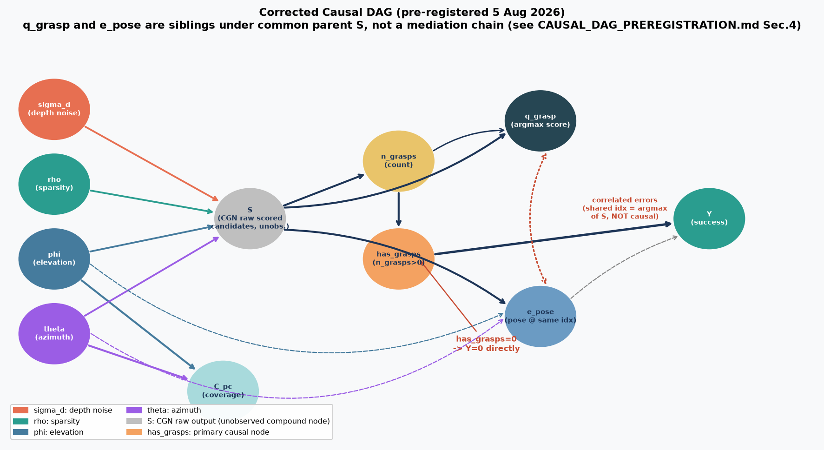
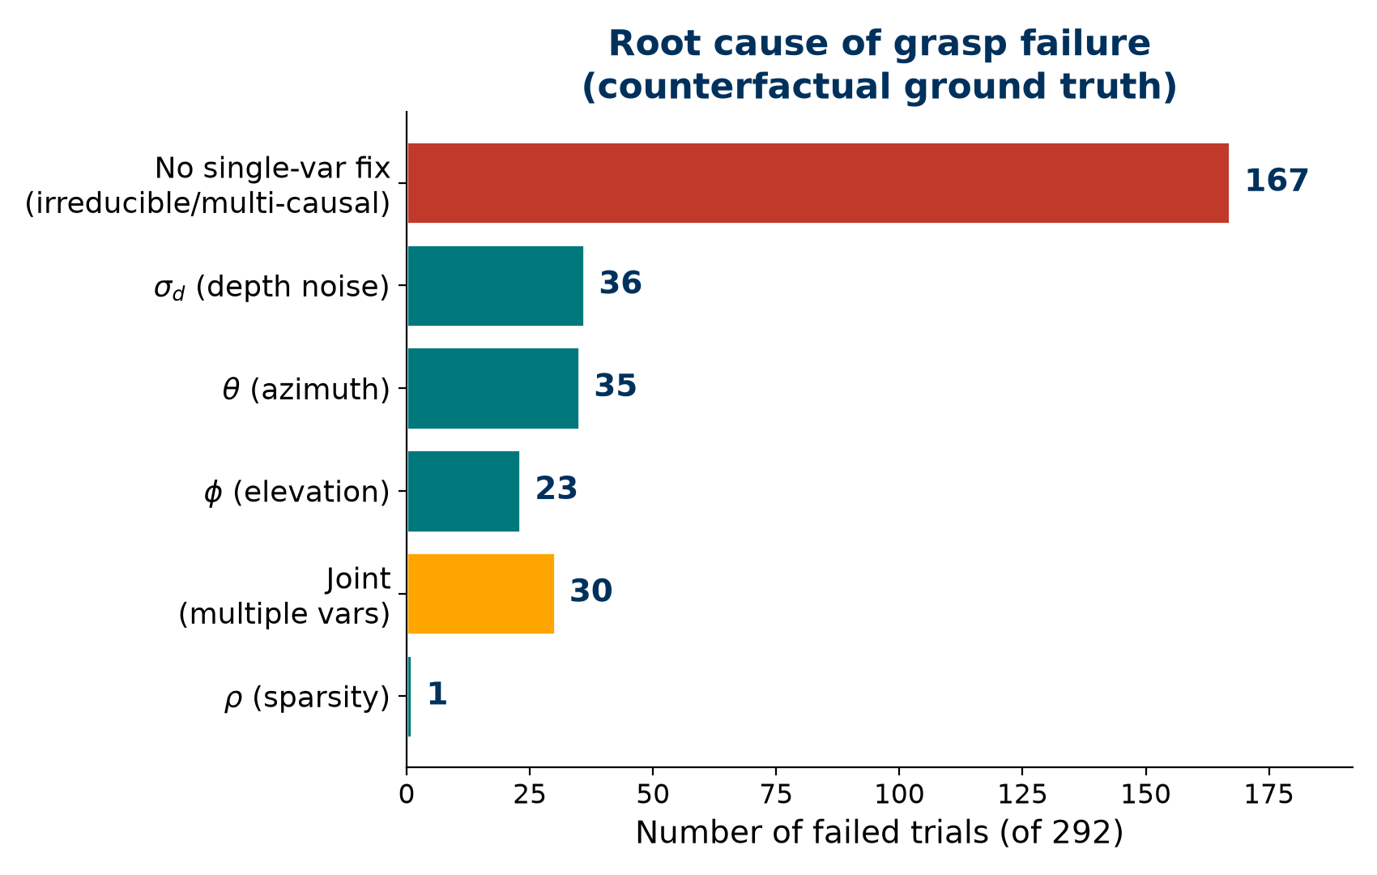
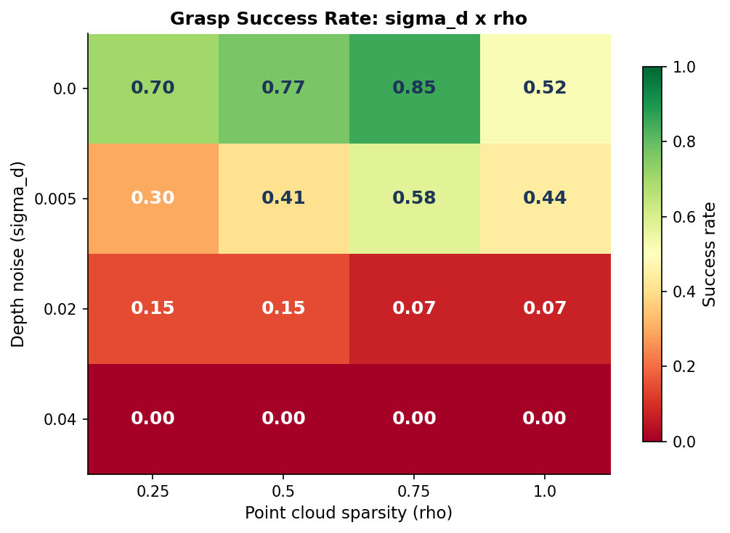
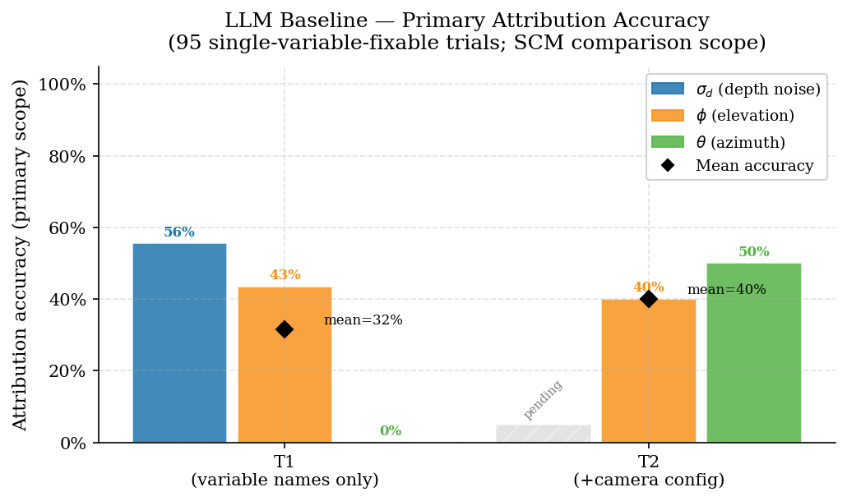
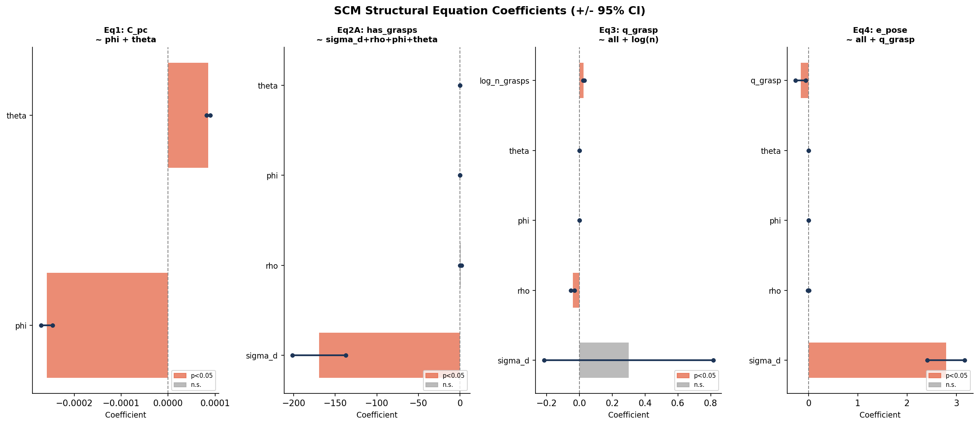
Masima, Bonolo
GUID: 2xxxxxxxM
Causal Inference for Robotic Grasp Failure Diagnosis under Perceptual Degradation
Can a Structural Causal Model diagnose why a robot grasp failed more reliably than a zero-shot LLM?
Robots frequently fail to grasp objects when perception is imperfect — noisy depth, sparse point clouds, or poor viewpoints — but knowing that a grasp failed is not the same as knowing why. This project builds a Structural Causal Model (SCM) that identifies which controlled perceptual perturbation (depth noise σᴅ, sparsity ρ, camera elevation φ, azimuth θ) caused a Contact-GraspNet grasp to fail, using Pearl's counterfactual (abduction→action→prediction) reasoning — and benchmarks its diagnostic accuracy against a zero-shot LLM given the same evidence.
Column 1 — Method & Causal Pipeline
Column 2 — Results & Contribution
1. Render
2. Degrade
3. Propose
4. Execute
5. Outcome
134 / 432
MuJoCo camera captures depth from viewpoint (φ,θ)
→
Inject noise σᴅ Downsample ρ → point cloud C_pc
→
Contact-GraspNet returns grasps + confidence q_grasp
→
Floating-gripper shake test on top-1 pose
→
Success / failure Y logged to CSV
trials succeeded (31.0%) across the full factorial grid — clear monotonic degradation as σᴅ↑ / ρ↓ / φ↑.
57.2%
The causal graph (dataflow-derived, dated pre-registration)
of failures (167/292) have no single-variable fix — irreducible or multi-causal, mostly at φ=60° (overhead geometry).
10.3% vs 57.2%
zero-shot LLM full-set diagnostic accuracy vs. the trivial “always guess ‘none’” majority-class baseline — the LLM underperforms a naive baseline.
Root cause of failure: single-cause vs. irreducible
Fig. 1 — Corrected causal DAG. Every edge/non-edge tested interventionally against the 432-trial dataset (test_dag_edges.py) — all tests passed.
Causal variables
Var
Role
Meaning
Domain
σᴅ
Exogenous
Gaussian depth-buffer noise
0, 0.005, 0.02, 0.04 m
Fig. 2 — Ground-truth primary cause per failed trial, from 1,168 counterfactual re-simulations.
ρ
Exogenous
Point cloud downsample fraction
1.0, 0.75, 0.5, 0.25
φ, θ
Exogenous
Camera elevation / azimuth
30–60°, 0–90°
SCM structural fit
C_pc
Mediator
Point cloud completeness
measured
q_grasp
Mediator
CGN top-1 confidence
measured
e_pose
Mediator
Grasp pose error vs. oracle
measured
Y
Outcome
Grasp success (shake test)
binary
Counterfactual diagnosis procedure (Pearl, 3-step)
• Abduction — infer the exogenous noise term ε for a failed trial from its observed evidence.
• Action — intervene do(σᴅ = 0), do(ρ = 1), etc., one variable at a time, holding ε fixed.
• Prediction — re-simulate; if success flips to 1, that variable is the diagnosed cause.
• Applied to all 292 real failed trials × 4 single-variable interventions = 1,168 re-simulations (ground truth).
SCM structural equations — fit quality
Fig. 3 — Success rate over the (σᴅ, ρ) grid. σᴅ dominates (OR≈0 at high noise); ρ effect is largely mediated through grasp count, not confidence.
Eq
Structural form
Method
Fit statistic
LLM baseline: diagnostic accuracy
Eq1
C_pc ~ φ + θ
OLS
R² = 0.893
Eq2A
has_grasps ~ σᴅ+ρ+φ+θ
Logistic
pseudo-R²=0.554, AUC=0.943
Eq2B
n_grasps ~ σᴅ+ρ+φ+θ
Neg. Binomial
σᴅ & ρ both sig.
Eq3
q_grasp ~ log(n_grasps)+…
OLS
R² = 0.699
Eq4
e_pose ~ σᴅ+ρ+…
OLS
ρ 90.9% mediated via q_grasp
Fig. 4 — Zero-shot LLM per-cause accuracy on the 95 trials with a clear single primary cause (overall 31.6%). Note: 0% on θ — azimuth failures are systematically missed.
Limitations & next steps
• SCM-vs-LLM head-to-head diagnostic accuracy: SCM counterfactual ranking on the 292 failed trials vs. ground truth — in progress.
• Single-object (cylinder) scene → multi-object redesign (box + mustard bottle, clutter, occlusion) underway per marker feedback.
• Recovery actions are out of scope — diagnosis only.
Fig. 1b — Fitted SCM coefficients per structural equation. σᴅ dominates pipeline collapse; ρ's effect is almost entirely mediated through grasp count / confidence, not a direct effect on C_pc.
Take-home message
A causal model can say not just that a grasp failed, but why — and, honestly, when it can't (57.2% of failures are irreducible to a single variable). Zero-shot LLMs, given the same evidence, currently underperform even a naive majority-class guess. The next step is a direct SCM-vs-LLM diagnostic accuracy comparison on the same 292 failed trials.
Bonolo Masima · MSc Robotics & AI · Supervisor: Dezong Zhao · School of Engineering, University of Glasgow
University of Glasgow, charity number SC004401

